Slide 1
Finals Review
CSC 458 Computer Networks

Slide 2
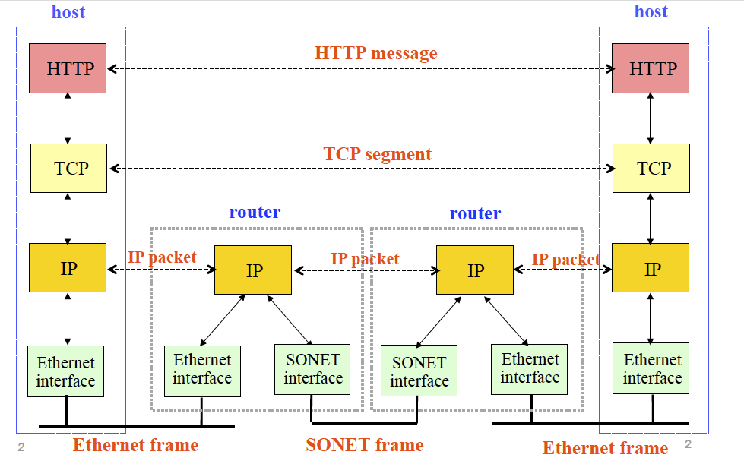
Internet Layering: Message, Segment, Packet and Frame
Notes:
Correct Ans: C

Slide 4
Topics
Transport Layer
UDP
TCP
Reliability
Congestion Control
Queueing and Management
Application Layer
Middleboxes
Overlay Networks
Network Security
SDN
Link Layer
Ethernet and CSMA/CD
Spanning Tree and Switching
DHCP and ARP
Network Layer
IPv4 addressing, CIDR
IP Forwarding
NATs, Firewalls, SDN
Routing Protocols
Autonomous Systems

Slide 5
Which of the following is/are true about Address Resolution Protocol (ARP) and learning bridges?
A learning bridge maintains state that maps IP addresses to hardware (MAC) addresses.
A learning bridge maintains state that maps MAC addresses to IP addresses.
A host’s ARP table maintains state that maps IP addresses to hardware (MAC) addresses.
A host’s ARP table maintains state that maps hardware addresses to IP addresses.
Notes:
Ans: C

Slide 6
Which one of the following is a true statement about TCP?
TCP is a routing protocol used throughout the Internet.
TCP establishes a connection between two end-hosts using a 2-way handshake scheme
TCP learns of congestion via packet loss or variations in delay.
If the SYN packet send by TCP source is lost, the connection is closed.
Notes:
ANS: C
A. TCP is a transport protocol therefore ! is false
B. TCP uses a 3-way handshake: (1) client->server Flags=SYN, SequenceNum=x; (2) server->client Flags=ACK, Ack=x+1 and Flags=SYN, SequenceNum=y; (3) client->server Flags=ACK, Ack=y+1. Hence B is not correct.
C. The sender would retransmit the SYN packet after the timeout. Hence D is not correct.

Slide 7
What is the name of the forwarding device in the middle of the diagram below?
Repeater
Switch
Hub
Router
Notes:
ANS: D

Slide 8
Which are true about Ethernet protocols?
Ethernet is commonly used for the link-layer protocol for long-distance links (such as across a country).
The Ethernet spanning tree may take a longer path through a network than that which would be calculated by a link-state algorithm (assuming both have converged).
The Maximum Transmission Unit (MTU) of Ethernet is dictated by the buffer size of the link-layer endpoints.
CRC error detection cannot always detect if there is a frame error in Ethernet.
Notes:
ANS: B, D
A false since ethernet is for short distance links
B is true since, ethernet routing not optimal simply avoids loops whereas dijkstra guarantees shortest path
C MTU is determined by bandwidth of link
D seems CRC not perfect

Slide 9
When a UDP segment arrives at a host, in order to direct the segment to the appropriate socket, the operating system’s network stack uses the following fields:
the source IP address
the destination IP address
the source port number
the destination port number
Notes:
NAS: B & D

Slide 10
Which of the following is/are true about web caches?
All HTTP objects are cacheable.
HTTP does not explicitly support caching or cache consistency.
A web cache, or proxy server, is a network entity that satisﬁes HTTP requests from clients.
A web cache is both a client and a server at the same time.
Notes:
ANS: C & D

Slide 11
Suppose a 10Mb/s adapter uses Manchester encoding to send an infinite stream of 1’s into a link. How many transitions per second will the signal emerging from this adapter have?
5 million transitions per second.
10 million transitions per second
20 million transitions per second.
None of the above.
Notes:
ANS: C
Manchester encoding results in 0 being encoded as a low-to-high transmision and 1 being encoded as a high-to-low transition. Because both 1s and 0s result in a transition to the signal, Manchester encoding doubles the rate at which signal transitions are made on the link. on Page 81 of text.

Slide 12
Which of the following is true about Random Early Detection (RED)?
RED is tolerant of bursts because when the average queue occupancy is close to the maximum threshold, there is still room in the queue to accept new burst of packets.
The possibility of RED dropping a packet belonging to a flow is proportional to the number of the flow’s packets queued at the router. (made possible by count)
RED drops packets with probability 1 when the router’s queue length is greater than the maximum threshold value. (statement always true, but drop happens when avgLen > maxthreshold)
If two flows, one TCP and one UDP, share a “RED” router, the RED algorithm will ensure that both flows receive identical share of the outgoing link. (RED works with TCP only. UDP does not retransmit, so can respond to queue of congestion, so will not slow down transmission)
Notes:
ANS: B
RED is the mechanism allows the router more accurately managing its queue length. But whether the average queue length is close to the MaxThreshold depends on several parameters: MaxThreshold, MaxP, Weight. Hence A is not correct.
RED operates on the queue length averaged over time, not instantaneous queue length. The incoming packet is dropped when the AVERAGE queue length is larger than the MaxThreshold. Hence C is not correct.
RED is designed to work in conjunction with TCP, not UDP. It works by implicitly sending signals to TCP flows to tell then to slow down the transmission by dropping one of its packets. But UDP doesn't monitor these signals, acting effectively the way as the "unresponsive flow" here, hence will not slow down the transmission, and eventually use more

Slide 13
Which of the following statements is TRUE about TCP?
TCP Segments can only be lost when router queues overflow. (maybe dropped by RED)
There is no performance benefit to having a window size larger than the receiver window size.
The received sees duplicate ACKs (with the same sequence number) only when a packet is lost (or delayed)
A receiver reduces the advertised window size in response to congestion (its for flow control not congestion control)
Notes:
ANS: B
A is not correct. As the TCP segment could be dropped by RED algorithm in some routers in the middle, even though the queue has not yet overflown.
B is correct. on page 408 of text: The sender is limited to having no more than a value of AdverisedWindow bytes of unacknowledged data at any given time.
The receiver would ACK every data packet it receives, even if its sequence number has been ACKed before. e.g., when a packet arrives out of order - when TCP cannot yet ACK the data packet contains because earlier data has not yet arrived - TCP resends the same ACK it sent the last time. Two possibilities occur there: the earlier packet is lost; or the earlier packet is delayed. on Page 511 of text. Hence C is not correct.
D is not correct. The advertized window reduction at the receiver side is a reaction of Flow control, not congestion control. Flow control is to prohibit the sender from over-running the receiver's buffer. Congestion control is to prohibit the sender from over-loading too much traffic into the network.

Slide 14
Consider an HTTP client that wants to retrieve a Web document at a given URL. The IP address of the HTTP server is initially unknown. What transport and application layer protocols besides HTTP are needed in this scenario?
Application layer protocols: DNS and HTTP
Transport layer protocols: UDP for DNS; TCP for HTTP

Slide 15
Why do HTTP, FTP and SMTP run on top of TCP rather than on UDP?
The applications associated with those protocols require that all application data be received in the correct order and without gaps. TCP provides this service whereas UDP does not.

Slide 16
What is the difference between Distance Vector and Path Vector?
DV – does not advertise entire network topology,
None of the routers how the network looks like in its entirety
Count to infinity problem
PV/LS - Link state routing protocols allow a router to have a complete map of the network, and use specific algorithms to find shortest paths to every object in the network
Link state protocols are much more complex and require more processing power and memory

Slide 17
Give two reasons why interdomain routing uses path-vector routing instead of distance vector routing.
Faster convergence through loop detection, avoiding the “counting to infinity” problem
Flexible routing policies that depend on the hops in the AS-PATH.

Slide 18
Show that 2D parity provides the receiver enough information to correct any 1-bit error, but not any 2-bit error.
If we know only one bit is bad, then 2-D parity tells us which row and column it is in, and we can then flip it. If, however, two bits are bad in the same row, then the row parity remains correct, and all we can identify is the columns in which the bad bits occur.

Slide 19
Give one reason why an Internet Service Provider (ISP) might select a route with a longer AS-PATH over a route with a shorter AS-PATH.
Avoids an undesirable AS (e.g. that performs censorship or wire-tapping)
Avoids an observed performance problem (e.g. high latency or low throughput)
Notes:
Avoid an undesirable AS, or avoid AS with observed performance problems

Slide 20
Describe three different scenarios when an IP router would drop packets that arrive on one of its interfaces.
Insufficient buffer space
No route for the destination
Badly formed packet (e.g., checksum error)
TTL expiry
Notes:
Not enough buffer
Bad checksum
TTL expired

Slide 21
A Network Address Translator (NAT) has a binding timer associated with each map entry. Why is this necessary?
Eventually, the NAT box needs to reclaim memory and port numbers to use for new data transfers. Also, a stale map entry could be viewed as a security risk, as an attacker could send packets to the hosts behind the NAT box using a source address and port number of a past transfer.
Notes:
NAT needs to reclaim memory and use for new data transfer
Security risk with a staleentry

Slide 22
How does the Border Gateway Protocol (BGP) avoid the count-to-infinity problem that plagues distance-vector protocols?
BGP is a path-vector protocol. That is, BGP announcements include the entire path traversed by the message, not simply a total cost. A router, upon receiving a BGP announcement, can check for its own AS number in the path; if the AS number is present, the path has a loop and is immediately discarded.
Notes:
BCP is path-vector algorithm,
Announces entire path traversed by message not simply a cost.
A router can check for its own AS number in path, if ASN present, then loop, and so discard pkt

Slide 23
Describe each of the following terms/concepts clearly and concisely. For each of these terms, explain the context they are defined at; which protocol(s) they are related to, when/where they are used, etc. and give examples if possible.
Fast Retransmission
Fast retransmission is used in TCP, to trigger the retransmission of a dropped packet sooner than the regular timeout mechanism. When the receiver receives an out-of-order packet, it resends the same acknowledgement it sent the last time. The sender who receives three duplicate ACKs then retransmit the dropped packet instead of waiting for the timeout of that packet. On page 511 of text.
Notes:
Fast retransmission
Used in TCP, to trigger retransmission of lost packet faster than timeout mechanism
When receiver gets out-of-order packets, it resends the same ack it sent last time
Sender receiving 3 duplicate acks then re-transmit the dropped packet instead of waiting for timeout

Slide 24
2. Nagle’s Algorithms
Nagle's algorithm is used by TCP senders to determine when to transmit a segment. The algorithm allows to send a full segment if the window permits. It also allows to send small amount of data if there are no segments in transit. Otherwise, if there is anything in flight, the TCP sender must wait for an ACK before transmitting the next segment. on Page 417 of text.
Notes:
Used in TCP to determine when to transmit a segment
The algorithm allows to send either any full segment if window permits or less than a full segment worth of data if there is no segment in transit
If there is anything in flight, then TCP must wait for acks before transmitting the next segment

Slide 25
3. Maximum Segment Size (MSS)
MSS is a variable used by TCP to determine the size of the largest segment to send. TCP waits until having collected MSS bytes from the sending process and then sends a segment. MSS is usually set to the MTU of the directly connected network, minus the size of the TCP and IP headers. on Page 415 of text.
Notes:
TCP
Determines size of largest segment to sent.
MSS = MTU – TCPhdrsize – Iphdrsize
TCP usuallly waits to have collected MSS byte then send a segment

Slide 26
4. Stub Autonomous System (AS)
A group of networks and routers, subject to a common authority and using the same intra-domain routing protocol.
Notes:
A group of networks and routers, subject to a common authority and using same intra-domain routing protocol.
Has relatively few degree

Slide 27
5. Interior Gateway Protocol (IGP)
The protocol used to exchange inter-domain routing information among routers in the same domain.
Notes:
Used to exchange routing information within an autonomous system

Slide 28
6. Distance Vector
A lowest-cost-path algorithm used in intra-domain routing. Each node advertises reachability information and associated costs to its immediate neighbors and uses the updates it receives to construct its forwarding table. The routing information protocol (RIP) uses a distance-vector algorithm. on Page 245 and Page 820 of text.
Notes:
Shortest-path algorithm used in intra-domain routing
Each node advertises reachability information and associated cost to its immediate neighbors
Each then updates forwrading table.
Routing information protocol RIP uses a distance-vector algorithm

Slide 29
TCP
Suppose Host A sends two TCP segments back to back to Host B over a TCP connection. The first segment has sequence number 90; the second has sequence number 110.
How much data is in the first segment?
20 Bytes
Suppose that the first segment is lost but the second segment arrives at B. In the acknowledgment that Host B sends to Host A, what will be the acknowledgment number?
ACK Number = 90 (the lost one)

Slide 30
What is an autonomous system? List and explain two type of routing protocols used in the autonomous system.
We use the term Autonomous System (AS) to capture the concept of groups of routers. An AS is a contiguous set of networks and routers all under control of one administrative authority. There is no exact meaning for administrative authority (the term is sufficiently flexible to accommodate many possibilities, but normally it means an organization, company or an ISP).
Interior Gateway Protocols (IGPs): The routers within an AS use an Interior Gateway Protocol (IGP) to exchange routing information. Several IGPs are available; each AS is free to choose its own IGP. An IGP is easy to install and operate, but an IGP may limit the size or routing complexity of an AS.
Exterior Gateway Protocols (EGPs): A router in one AS uses an Exterior Gateway Protocol (EGP) to exchange routing information with a router in another AS. EGPs are usually more complex to install and operate than IGPs, but EGPs offer more flexibility and lower overhead (i.e., less traffic). An EGP can implement policy constraints that allow a system manager to determine exactly what information is released outside the organization.
Notes:
Autonomous system is a group of routers. A close set of networks under control of 1 administrative authority
IGP: used within AS, exchange routing info between routers. Eacy to install
EGP: exchange routing info with a router in another AS. Complex to install, more flexible, lower overhead, implement policy constraint

Slide 31
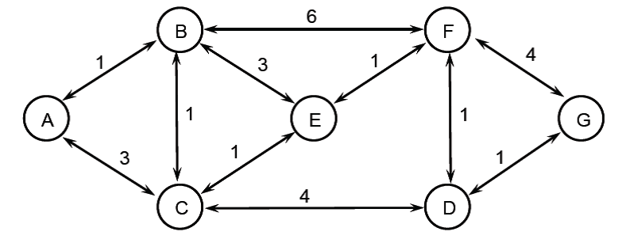
Consider the network topology shown below. If we use Bellman-Ford’s algorithm to find the shortest path between every pair of nodes, how many steps will it take for the algorithm to converge in the case? Explain
Notes:
You don’t need to compute the distance vectors to find out the answer of this question. You can simply find the length of the longest simple unweighted path in the graph.
So 6 steps are needed.
So the following calculations are not necessary for this question.
Step1 (0,1,3,inf,inf,inf,inf; 1,0,1,inf,3,6,inf; 3,1,0,4,1,inf,inf; inf,inf,4,0,inf,1,1; inf,3,1,inf,0,1,inf; inf,6,inf,1,1,0,4; inf,inf,inf,1,inf,4,0).
Step2 (0,1,2,7,4,7,inf; 1,0,1,5,2,4,10;2,1,0,4,1,2,5; 7,5,4,0,2,1,1; 4,2,1,2,0,1,5; 7,4,2,1,1,0,2; inf,10,5,1,5,2,0).
Step3 (0,1,2,6,3,5,8; 1,0,1,5,2,3,6; 2,1,0,3,1,2,5; 6,5,3,0,2,1,1; 3,2,1,2,0,1,3; 5,3,2,1,1,0,2; 8,6,5,1,3,2,0).
Step4 (0,1,2,6,3,4,7; 1,0,1,4,2,3,6; 2,1,0,3,1,2,4; 6,4,3,0,2,1,1; 3,2,1,2,0,1,3; 4,3,2,1,1,0,2; 7,6,4,1,3,2,0).
Step5 (0,1,2,5,3,4,7; 1,0,1,4,2,3,5; 2,1,0,3,1,2,4; 5,4,3,0,2,1,1; 3,2,1,2,0,1,3; 4,3,2,1,1,0,2; 7,5,4,1,3,2,0).
Step 6 (0,1,2,5,3,4,6; 1,0,1,4,2,3,5; 2,1,0,3,1,2,4; 5,4,3,0,2,1,1; 3,2,1,2,0,1,3; 4,3,2,1,1,0,2; 6,5,4,1,3,2,0)

Slide 32
In general, if we have a network with N nodes, what is the maximum number of steps for the Bell-Ford algorithm to converge? Explain.
N-1 steps for the worse case.
Notes:
N-1 steps for the worse case.

Slide 33
Ethernet switches compute a spanning tree using the spanning tree protocol. Explain briefly how the spanning tree protocol works.
The spanning tree protocol is designed to eliminate loops in the forwarding topology. It provides a distributed manner for individual switches to cooperatively form a spanning tree topology: each switch first declares itself as the root and passes the configuration messages out to each of its interfaces identifying itself as the root with distance 0. Switches periodically receive these messages from their neighbours and update their view of the root. Upon receiving a message, a switch checks the root id. If the new id is smaller than the recorded one, it starts viewing that switch as root.
Switches compute their distance from he root. Also they add 1 to the distance received from a neighbour. Comparing these two values, they identify interfaces which are not on a shortest path to the root and exclude them from the spanning tree.

Slide 34
Do the switches learn the network topology (connecting the switches), like routers do in a link-state protocol? Does each pair of switches communicate over a shortest path, like routers do in link-state protocols?
The spanning tree protocol is different from the link-state protocol. The first difference is the content exchanged between nodes - both the reachability and distance are exchanged in spanning tree configuration messages; only the reachability information is exchanged in link-state protocol.
The second difference is that the shortest paths (from each switch to the root) are formed at the same time of forming the tree topology in Spanning tree protocol, whereas the shortest paths are calculated in the second stage after every node has learnt the network topology in the link-state protocol.
The third difference is that the switches in spanning tree protocol only learn their paths to the root; but the routers learns their paths to all other routers in link-state protocol.
Notes:
Spanning tree algorithm exchanges reachability as well as cost info
Switches learn path to root only, but router learns path to all other routes

Slide 35
Consider a TCP flow over a 1-Gb/s link with a latency of 1 second that transfers a 10 MB file. The receiver advertises a window size of 1MB, and the sender has no limitation on its congestion window (i.e., it can go beyond 64 KB).
How many RTTs does it take until slow-start opens the send window to 1 MB?
Assuming TCP packet size is 1500 Bytes, 1MB is about 1000000/1500=667 packets.
Starting from initial congestion window size of 1 packet, after each RTT the window size doubles. Therefore, we need to find the smallest n such that:
2^n>=667 => n=10
After 10 RTTs the window size opens to 1Mb which equals to the advertised window size.

Slide 36
How many RTTs does it take to send the file?
During the first 10 RTTs of slow-start, 1500B*(1+2+4+…+512) = 1534500B is transmitted. Starting from the 11th RTT, the sender will send 1MB to the network. Hence the remaining file takes (10MB-1.5345)/1MB = 8.4655 RTT to finish. Hence in total, it takes 10RTT + 9RTT = 19RTT to send the file.

Slide 37
If the time to send the file is given by the number of required RTTs multiplied by the link latency, what is the effective throughput of the transfer
Throughput = Transfer Size / Transfer Time = 10 MB / 19*1 second = 0.5263 MB/s
(We assume that the ACKs are immediately received and so the latency is 1sec)

Slide 38
What percentage of the link bandwidth is utilized?
Utilization = 0.5263*8 Mbps / 1000 Mbps = 0.42 %

Slide 39
Suppose we have the forwarding tables shown below for nodes A and F, in a network where all links have cost 1. Give a diagram of the smallest network consistent with these tables.
NODE A |  |  |  | NODE F
Node | Cost | Next Hop |  | Node | Cost | Next Hop
B | 1 | B |  | A | 3 | E
C | 2 | B |  | B | 2 | C
D | 1 | D |  | C | 1 | C
E | 2 | B |  | D | 2 | E
F | 3 | D |  | E | 1 | E
A
B
C
D
E
F

Slide 40
Below is a picture of a network with 2 bridges and 1 router. Each interface is labeled with both an IP address and a MAC address. Imagine that host H1 (SRC) is sending a packet to host H2 (DST). Answer the following questions:

Slide 41
How many networks are shown above?
3, the networks hanging off R2
Just before the packet reaches bridge B1, what is its layer 2 (Link Layer) destination?
R2a.mac
Just before the packet reaches bridge B2, what is its layer 2 (Link Layer) source?
R2c.mac
Just before the packet leaves router R2, what is its layer 3 source?
H1.ip
Notes:
Mac always set to router and not bridges/switches

Slide 42
When H1 sends out an ARP query, what is the reply to that query? (only router replies)
R2a.mac has R2a.ip
Does the entry B2a.mac appear in B1’s forwarding table?
NO, B2a is on a different network than B1

Slide 43
A “tier 1” ISP is an AS with no upstream providers of its own. Why do the tier-1 ASes form a clique (i.e., a fully-connected topology), where each tier-1 ISP connects directly to every other tier-1 ISP?
A tier-1 ISP has no upstream providers of its own. As such, it cannot reach the (single-homed) customers of other tier-1 ISPs without peering with them.
Notes:
Since no provider. Cannot reach customer of another tier1 AS without peering with them

Slide 44
Suppose AS 1 has an AS-PATH of “1 2 3 4” to reach prefixes in AS 4, and ASes 3 and 4 have a peer-peer relationship. Suppose that an AS does not export BGP routes learned from one peer/provider to another peer/provider. Is AS 2 a customer, peer, or provider of AS 1?
AS3 would only announce customer-learned routes to AS4, implying that AS2 is a customer of AS3.
Similarly, AS2 would only announce customer-learned routes to AS3, implying AS1 is a customer of AS2.
As such, AS2 is a provider of AS1.

Slide 45
We have seen that TCP has a number of features that UDP does not. For each of the following problems that can occur in IP networks, explain how TCP supports reliable delivery.
Dropped packets
TCP detects packet drops and retransmits lost portions
Reordered packets
TCP's sliding window mechanism buffers out of order packets and delivers packets in-order to the application

Slide 46
In TCP’s congestion control mechanism, what is the purpose of 1) slow start and 2) congestion avoidance?
Slow start’s main purpose is to quickly get the window size up to the connection’s capacity, so that the link’s bandwidth is not wasted. As soon as a duplicate ACK is received, or the threshold size is reached, those are taken to be indicators that the window size is approaching capacity, and switches to congestion avoidance.
Congestion avoidance tries to detect when the link quality is degrading, usually due to congestion (too many users trying to send too many packets), and quickly decreases the window size to decrease usage of it. It halves the window size to play it safe. Ideally, if all the users on the link do this, the link will be able to recover, and all the users will be back in slow start, trying to gauge the link’s capacity.

Slide 47
Using TCP, a sender has sent out packets 1 through 20. The sender receives an ACK for packet 10, then it receives three ACKS for packet 11 (i.e., if the final byte of packet 11 was byte no. 5000, then these ACKs were for byte 5001). Given this result:
Which of the 20 packets can the sender assume are lost?
12

Slide 48
Which of the 20 packets can the sender assume were definitely received?
1 - 11
Now, the same sender resends the next missing packet and receives an ACK for packet 16 in response. Based on this information:
Which packets of the original 20 can the sender assume are still lost, if any?
None (other acks maybe in transit)
Which of the original 20 can the sender assume were definitely received?
1 - 16

